Slide 1
Optimizing Apache Spark
Optimizing with AQE & DPP
Join Optimizations

Slide 2
Optimizing with AQE & DPP
AQE - Join Optimization
Joins can be optimized at runtime, for example:
Table sizes are estimated at planning:
A large table is estimated to be 100 GB
A small table is estimated to be 11 MB and thus not a candidate for auto-broadcasting
Both tables are read in as a distinct stages, but in parallel
At runtime, the small table comes in under the 10 MB threshold
At runtime, AQE adjusts the physical plan to broadcast the small table or potentially employ other strategies like subqueries
Notes:
In parallel is a key point here - this is a new feature of Spark 3 which doesn’t require all stages to run sequentially
It does how affect how we design our clusters because we no longer use the max-number-of-tasks across all stages to compute number of cores. Now it is the max of any 2+ stages that may be ran at the same time
From Jacob - Even though it is advertised in various videos and write ups, I have yet to reproduce the case where a table is over 10 MB, filtered and is now suitable for broadcasting. All my experiments seem to favor using subqueries instead (which are technically broadcasted). Even with AQE turned off, you will see subqueries under spark 3

Slide 3
Optimizing with AQE & DPP
AQE - Join Optimization, In Action
See Experiment #3799A
Contrast the Query Plans for the last job for Step C (standard) and Step D (w/AQE)
What major difference is there between the two Query Plans?

Slide 4
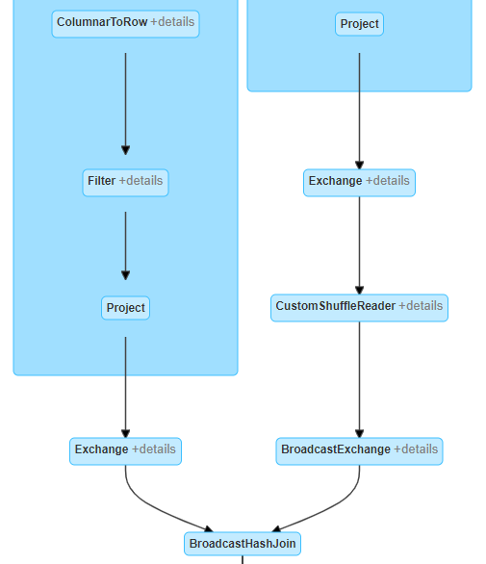
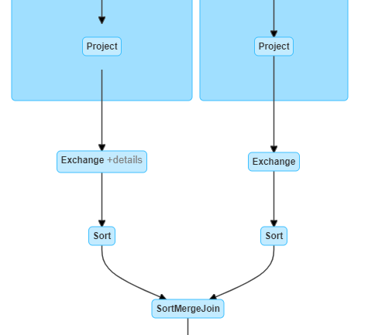
Optimizing with AQE & DPP
AQE - Join Optimization, Review
Kind of Cool: Run the query, and it will initially show a SortMergeJoin. Once the ingest stages (left & right of join) completes, the query and physical plan will update to use a BroadcastHashJoin

Slide 5
Optimizing with AQE & DPP
Join Optimization - Options
See Converting sort-merge join to broadcast join for more information
Property Name | Default | Meaning
spark.sql.adaptive.localShuffleReader.enabled | true | AQE converts sort-merge join to broadcast hash join when the runtime statistics of any join side is smaller than the broadcast hash join threshold
spark.sql.adaptive.nonEmptyPartitionRatioForBroadcastJoin | 0.2 | The relation with a non-empty partition ratio lower than this config will not be considered as the build side of a broadcast-hash join in adaptive execution regardless of its size.
Notes:
UNPUBLISHED - As of writing this course (05-27-2020), the following options have yet to be published
There is a gotcha here! If the partition has too many empty records, then it won’t be broadcast because it creates a scenario where the overhead of broadcasting empty partitions can be better addressed by other solutions.
You can force it to broadcast in this case by setting spark.sql.adaptive.nonEmptyPartitionRatioForBroadcastJoin to 0 (ignoring that the “Meaning” listed above is REALLY confusing.

